Slide 1









Whiteboardmaths.com
7
2
1
5
© 2004 All rights reserved

Slide 2
Prime and Composite Numbers
The positive integers (excluding 1) can be divided into two sets.
primes
1
2
3
4
5
6
7
8
9
10
11
12
13
14
15
16
17
18
19
20
21
22
23
24
25
26
27
28
29
30
composites
31
32
33
34
35
36
37
38
39
40
41
42
43
44
45
46
47
48
49
50
All composite numbers can be expressed as a product of primes. For example:
51
52
53
54
55
56
57
58
59
60
61
62
63
64
65
66
67
68
69
70
55
=
5 x 11
71
72
73
74
75
76
77
78
79
80
70
=
2 x 5 x 7
81
82
83
84
85
86
87
88
89
90
91
92
93
94
95
96
97
98
99
100
90
=
2 x 3² x 5
You may be familiar with these from the Sieve of Eratosthenes.

Slide 3
M1
The Fundamental Theorem of Arithmetic
Every positive integer (excluding 1) can be expressed as a product of primes and this factorisation is unique (Euclid IX.14).
To write a number as a product of primes first write it as a product of any two convenient factors.
Example 1: Write 180 as a product of primes.
180 = 10 x 18
None of these factors are prime so re-write them as a product of smaller factors and keep repeating if necessary until all factors are prime.
180 = 2 x 5
x 3 x 6
180 = 2 x 5 x 3 x 2 x 3
All factors are now prime so re-write in ascending order as powers.
180 = 2² x 3² x 5
When written in this way we say that it is expressed in canonical form.

Slide 4
The Fundamental Theorem of Arithmetic
Every positive integer (excluding 1) can be expressed as a product of primes and this factorisation is unique (Euclid IX.14).
To write a number as a product of primes first write it as a product of any two convenient factors.
Example 2: Write 200 as a product of primes.
200 = 10 x 20
None of these factors are prime so re-write them as a product of smaller factors and keep repeating if necessary until all factors are prime.
200 = 2 x 5
x 4 x 5
200 = 2 x 5 x 2² x 5
All factors are now prime so re-write in canonical form.
200 = 2³ x 5²

Slide 5
The Fundamental Theorem of Arithmetic
Every positive integer (excluding 1) can be expressed as a product of primes and this factorisation is unique (Euclid IX.14).
To write a number as a product of primes first write it as a product of any two convenient factors.
Example 3: Write 84 as a product of primes.
84 = 7 x 12
84 = 7 x 3 x 4
84 = 7 x 3 x 2²
84 = 2² x 3 x 7

Slide 6
The Fundamental Theorem of Arithmetic
Every positive integer (excluding 1) can be expressed as a product of primes and this factorisation is unique (Euclid IX.14).
To write a number as a product of primes first write it as a product of any two convenient factors.
Example 4: Write 144 as a product of primes.
144 = 12 x 12
144 = 3 x 4 x 3 x 4
144 = 3 x 2² x 3 x 2²
144 = 2⁴ x 3²

Slide 7
The Fundamental Theorem of Arithmetic
Every positive integer (excluding 1) can be expressed as a product of primes and this factorisation is unique (Euclid IX.14).
To write a number as a product of primes first write it as a product of any two convenient factors.
Example 5: Write 484 as a product of primes.
484 = 4 x 121
484 = 2² x 11²

Slide 8
The Fundamental Theorem of Arithmetic
Every positive integer (excluding 1) can be expressed as a product of primes and this factorisation is unique (Euclid IX.14).
To write a number as a product of primes first write it as a product of any two convenient factors.
Example 6: Write 245 as a product of primes.
245 = 5 x 49
245 = 5 x 7²

Slide 9
Questions
The Fundamental Theorem of Arithmetic
Every positive integer (excluding 1) can be expressed as a product of primes and this factorisation is unique (Euclid IX.14).
To write a number as a product of primes first write it as a product of any two convenient factors.
Questions: Write the following as a product of primes.
(a) 65
= 5 x 13
(f) 350
= 2 x 5² x 7
(b) 150
= 2 x 3 x 5²
(g) 96
= 2⁵ x 3
(c) 24
= 2³ x 3
(h) 81
= 3⁴
(d) 56
= 2³ x 7
(i) 420
= 2² x 3 x 5 x 7
(e) 400
= 2⁴ x 5²
(j) 1000
= 2³ x 5³

Slide 10
M2
The Fundamental Theorem of Arithmetic
Every positive integer (excluding 1) can be expressed as a product of primes and this factorisation is unique (Euclid IX.14).
An alternative but usually less efficient approach is simply to test for divisibility by primes in ascending order.
Example (a) Write 168 as a product of primes.
2
168
168 is even so divide by the first prime (2) and keep repeating if necessary.
2
84
2
42
3
21
7
21 is not divisible by 2 so move to the next prime (3).
168 = 2³ x 3 x 7
7 is prime so we are finished.

Slide 11
The Fundamental Theorem of Arithmetic
Every positive integer (excluding 1) can be expressed as a product of primes and this factorisation is unique (Euclid IX.14).
An alternative but usually less efficient approach is simply to test for divisibility by primes in ascending order.
Example (b) Write 630 as a product of primes.
2
630
Divisible by 2
3
315
Divisible by 3
3
105
Divisible by 3 again
5
35
Divisible by 5
7
Prime
630 = 2 x 3² x 5 x 7

Slide 12
The Fundamental Theorem of Arithmetic
Every positive integer (excluding 1) can be expressed as a product of primes and this factorisation is unique (Euclid IX.14).
An alternative but usually less efficient approach is simply to test for divisibility by primes in ascending order.
Example (d) Write 4158 as a product of primes.
2
4158
Divisible by 2
3
2079
Divisible by 3 (digit sum is a multiple of 3)
3
693
Divisible by 3 (digit sum is a multiple of 3)
3
231
Divisible by 3 (digit sum is a multiple of 3)
7
77
Not divisible by 5 so go to next prime (7)
11
Prime
This method is useful when you have large numbers and/or you cannot readily spot two convenient factors.
4158 = 2 x 3³ x 7 x11

Slide 13
HCF
The Fundamental Theorem of Arithmetic
Every positive integer (excluding 1) can be expressed as a product of primes and this factorisation is unique (Euclid IX.14).
Problems that involve finding Highest Common Factors (HCF) and Lowest Common Multiples (LCM) of large numbers can be solved efficiently by using prime decomposition.
Example (1) Find the HCF of 165 and 550
165 = 3 x 5 x 11
550 = 2 x 5² x 11
Since 5 and 11 divide both numbers the HCF = 5 x 11 = 55

Slide 14
The Fundamental Theorem of Arithmetic
Every positive integer (excluding 1) can be expressed as a product of primes and this factorisation is unique (Euclid IX.14).
Problems that involve finding Highest Common Factors (HCF) and Lowest Common Multiples (LCM) of large numbers can be solved efficiently by using prime decomposition.
Example (2) Find the HCF of 630 and 756
630 = 2 x 3² x 5 x 7
756 = 2² x 3³ x 7
Since 2, 3² and 7 divide both numbers the HCF = 2 x 3² x 7 = 126

Slide 15
The Fundamental Theorem of Arithmetic
Every positive integer (excluding 1) can be expressed as a product of primes and this factorisation is unique (Euclid IX.14).
Problems that involve finding Highest Common Factors (HCF) and Lowest Common Multiples (LCM) of large numbers can be solved efficiently by using prime decomposition.
Example (3) Find the HCF of 5400 and 3000
5400 = 2³ x 3³ x 5²
3000 = 2³ x 3 x 5³
Since 2³, 3 and 5² divide both numbers, the HCF = 2³ x 3 x 5² = 600

Slide 16
Questions
The Fundamental Theorem of Arithmetic
Every positive integer (excluding 1) can be expressed as a product of primes and this factorisation is unique (Euclid IX.14).
Problems that involve finding Highest Common Factors (HCF) and Lowest Common Multiples (LCM) of large numbers can be solved efficiently by using prime decomposition.
Questions: Find the HCF of the pairs of numbers below.
(a) 78 and 117
HCF = 39
78 = 2 x 3 x 13
117 = 3² x 13
∴ HCF = 3 x 13 = 39
(b) 2205 and 2079
HCF = 63
2205 = 3² x 5 x 7²
2079 = 3³ x 7 x 11
∴ HCF = 3² x 7 = 63

Slide 17
LCM
The Fundamental Theorem of Arithmetic
Every positive integer (excluding 1) can be expressed as a product of primes and this factorisation is unique (Euclid IX.14).
Problems that involve finding Highest Common Factors (HCF) and Lowest Common Multiples (LCM) of large numbers can be solved efficiently by using prime decomposition.
Example (a) Find the LCM of 65 and 70
65 = 5 x 13
70 = 2 x 5 x 7
The LCM must be a multiple of 70. That is, it must include the prime factors 2, 5 and 7.
Additionally, it will have to have 13 as a prime factor.
So LCM = 2 x 5 x 7 x 13 = 910

Slide 18
The Fundamental Theorem of Arithmetic
Every positive integer (excluding 1) can be expressed as a product of primes and this factorisation is unique (Euclid IX.14).
Problems that involve finding Highest Common Factors (HCF) and Lowest Common Multiples (LCM) of large numbers can be solved efficiently by using prime decomposition.
Example (b) Find the LCM of 24 and 60
Any multiple of 24 must be divisible by 8.
60 is divisible by 4 but not by 8.
24 = 2³ x 3
60 = 2² x 3 x 5
Choosing the highest powers of all prime factors.
LCM = 2³ x 3 x 5 = 120
Can you see why we have to choose the highest power?

Slide 19
The Fundamental Theorem of Arithmetic
Every positive integer (excluding 1) can be expressed as a product of primes and this factorisation is unique (Euclid IX.14).
Problems that involve finding Highest Common Factors (HCF) and Lowest Common Multiples (LCM) of large numbers can be solved efficiently by using prime decomposition.
Example (c) Find the LCM of 504 and 378
Again any multiple of 504 must be divisible by 8.
Also any multiple of 378 must be divisible by 27
504 = 2³ x 3² x 7
378 = 2 x 3³ x 7
Choosing the highest powers of all prime factors.
LCM = 2³ x 3³ x 7 = 1512
Can you see why we have to choose the highest power?

Slide 20
Questions
The Fundamental Theorem of Arithmetic
Every positive integer (excluding 1) can be expressed as a product of primes and this factorisation is unique (Euclid IX.14).
Problems that involve finding Highest Common Factors (HCF) and Lowest Common Multiples (LCM) of large numbers can be solved efficiently by using prime decomposition.
Questions: Find the LCM of the pairs of numbers below
(a) 40 and 100
LCM = 200
40 = 2³ x 5
100 = 2² x 5²
∴ LCM = 2³ x 5² = 200
(b) 18 and 56
LCM = 504
18 = 2 x 3²
56 = 2³ x 7
∴ LCM = 2³ x 3² x 7 = 504

Slide 21


Cars
Example Question: Two toy cars go round a racing track. They start at the same place and time. The blue car completes a circuit every 28 seconds, and the red car completes a circuit every 30 seconds. After how long will they be lined up again in the same position?
Inspecting the prime factors of 28 an 30.
28 = 2² x 7
30 = 2 x 3 x 5
The LCM = 2² x 3 x 5 x 7 = 420
The cars will be lined up again after 420 seconds = 7 minutes

Slide 22

Planets
Question: In a galaxy far, far, away, three giant gas planets orbit a bright star. It is the year 5634 and the three planets are lined up as shown in the diagram. These planets take 8, 9 and 10 years (Earth years) respectively to orbit their sun. In what year will all three planets be lined up again in the same position?
8 years
9 years
10 years
Inspecting the prime factors of 8, 9 and 10.
8 = 2³
9 = 3²
10 = 2 x 5
The LCM = 2³ x 3² x 5 = 360
The planets will be lined up again after 360 years (in 5994)

Slide 23
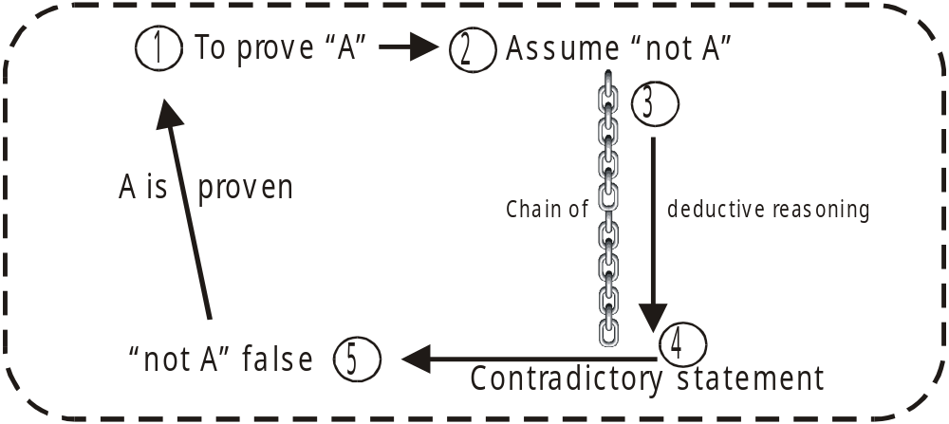
From (Miscellaneous Greek Proofs)
The Fundamental Theorem of Arithmetic: Every positive integer (excluding 1) can be expressed as a product of primes and this factorisation is unique (Euclid IX.14).
The first part of this result is needed for the proof of the infinity of primes (Euclid IX.20) which follows shortly.
The type of proof used is a little different and is known as “Reductio ad absurdum”. It was first exploited with great success by ancient Greek mathematicians. The idea is to assume that the premise is not true and then apply a deductive argument that leads to an absurd or contradictory statement. The contradictory nature of the statement means that the “not true” premise is false and so the premise is proven true.

Slide 24
Any whole number is either prime or can be expressed as a product of its prime factors.
2 | 3 | 4 | 5 | 6 | 7 | 8 | 9 | 10 | 11
prime | prime | 2² | prime | 2 x 3 | prime | 2³ | 3² | 2 x 5 | prime
12 | 13 | 14 | 15 | 16 | 17 | 18 | 19 | 20 | 21
2² x 3 | prime | 2 x 7 | 3 x 5 | 2⁴ | prime | 2 x 3² | prime | 2² x 5 | 3 x 7
22 | 23 | 24 | 25 | 26 | 27 | 28 | 29 | 30 | 31
2 x 11 | prime | 2³ x 3 | 5² | 2 x 13 | 3³ | 2² x 7 | prime | 2 x 3 x 5 | prime
32 | 33 | 34 | 35 | 36 | 37 | 38 | 39 | 40 | 41
2⁵ | 3 x 11 | 2 x 17 | 5 x 7 | 2² x 3² | prime | 2 x 19 | 3 x 13 | 2³ x 5 | prime
42 | 43 | 44 | 45 | 46 | 47 | 48 | 49 | 50 | 51
2 x 3 x 7 | prime | 2² x 11 | 3² x 5 | 2 x 23 | prime | 2⁴ x 3 | 7² | 2 x 5² | 3 x 17
52 | 53 | 54
2² x 13 | prime
2 x 3³
It is quite easy to see that any number is either prime or can be expressed as a product of primes. Suppose that we check this for all numbers up to a certain number.
For example: Assume that 54 is the smallest non–prime number that we suspect cannot be expressed as a product of primes. Since it is composite, it can be written as a product of two smaller factors. These factors are either prime or have already been written as a product of primes (6 x 9 or 3 x 18).

Slide 25
Any whole number is either prime or can be expressed as a product of its prime factors.
2 | 3 | 4 | 5 | 6 | 7 | 8 | 9 | 10 | 11
prime | prime | 2² | prime | 2 x 3 | prime | 2³ | 3² | 2 x 5 | prime
12 | 13 | 14 | 15 | 16 | 17 | 18 | 19 | 20 | 21
2² x 3 | prime | 2 x 7 | 3 x 5 | 2⁴ | prime | 2 x 3² | prime | 2² x 5 | 3 x 7
22 | 23 | 24 | 25 | 26 | 27 | 28 | 29 | 30 | 31
2 x 11 | prime | 2³ x 3 | 5² | 2 x 13 | 3³ | 2² x 7 | prime | 2 x 3 x 5 | prime
32 | 33 | 34 | 35 | 36 | 37 | 38 | 39 | 40 | 41
2⁵ | 3 x 11 | 2 x 17 | 5 x 7 | 2² x 3² | prime | 2 x 19 | 3 x 13 | 2³ x 5 | prime
42 | 43 | 44 | 45 | 46 | 47 | 48 | 49 | 50 | 51
2 x 3 x 7 | prime | 2² x 11 | 3² x 5 | 2 x 23 | prime | 2⁴ x 3 | 7² | 2 x 5² | 3 x 17
52 | 53 | 54
2² x 13 | prime
7038
2 x 3³
This argument can obviously be extended to larger numbers.
7038
= 46 x 153
= 2 x 3² x 17 x 23
This could be generalised for any whole number N, by using a “reductio” type argument as follows:

Slide 26
Any Number Can Be Expressed As a Product of Primes
2 | 3 | 4 | 5 | 6 | 7 | 8 | 9 | 10 | 11
 |  | 2² |  | 2 x 3 |  | 2³ | 3² | 2 x 5
12 | 13 | 14 | 15 | 16 | 17 | 18 | 19 | 20 | 21
2² x 3 |  | 2 x 7 | 3 x 5 | 2⁴ |  | 2 x 3² |  | 2² x 5 | 3 x 7
22 | 23 | 24 | 25 | 26 | 27 | 28 | 29 | 30 | 31
2 x 11 |  | 2³ x 3 | 5² | 2 x 13 | 3³ | 2² x 7 |  | 2 x 3 x 5
32 | 33 | 34 | 35 | 36 | 37 | 38 | 39 | 40 | 41
2⁵ | 3 x 11 | 2 x 17 | 5 x 7 | 2² x 3² |  | 2 x 19 | 3 x 13 | 2³ x 5
42 | 43 | 44 | 45 | 46 | 47 | 48 | 49 | 50 | 51
2 x 3 x 7 |  | 2² x 11 | 3² x 5 | 2 x 23 |  | 2⁴ x 3 | 7² | 2 x 5² | 3 x 17
52 | 53 | 54
2² x 13
7038
2 x 3³
Assume N is the smallest number that cannot be expressed as a product of primes.
Since N is composite (otherwise it would be prime), N = p x q, both less than N.
Since p and q are smaller than N they are either prime or a product of primes.
Therefore the assumption is wrong and N can be written as a product of prime factors.
There is no smallest N that cannot be expressed as a product of primes.
Any number can be expressed as a product of primes. QED

Slide 27
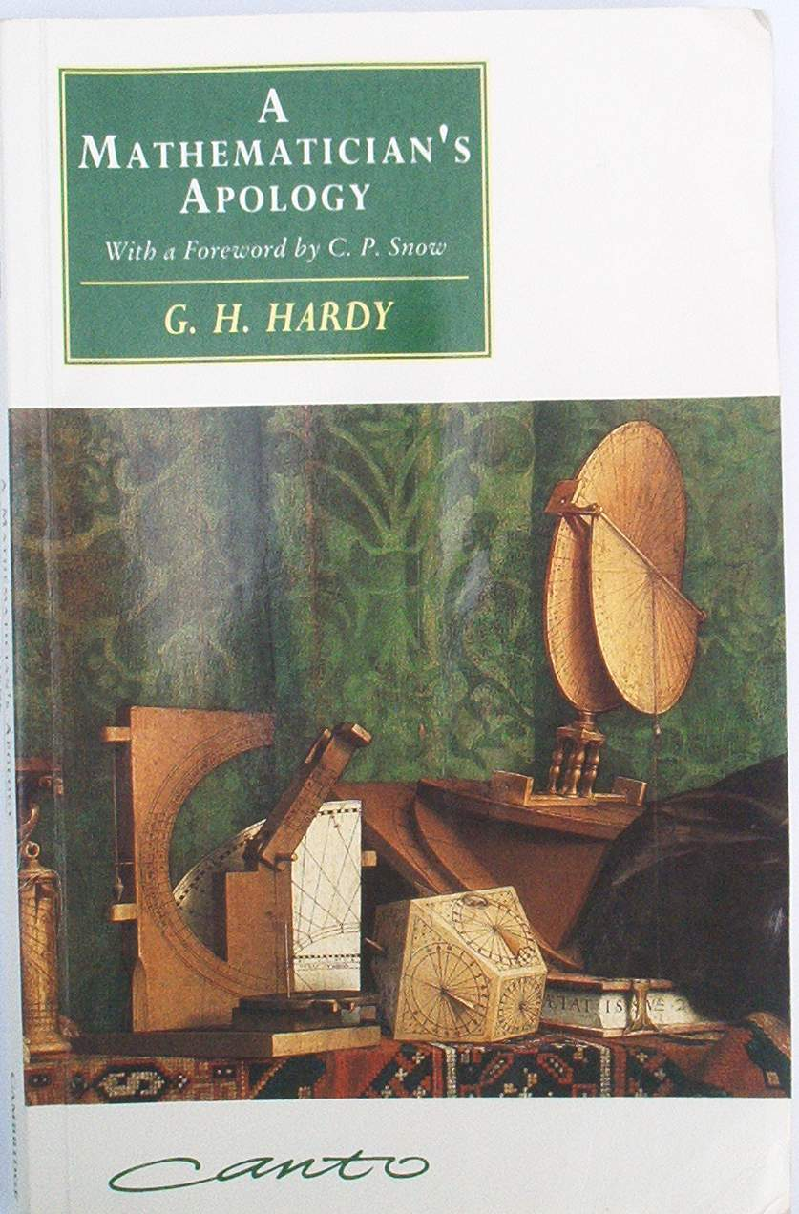
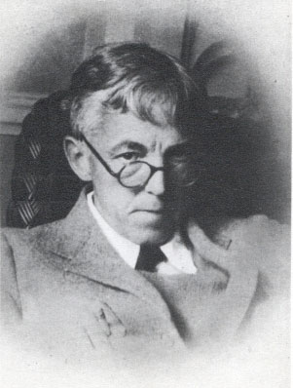
In G.H. Hardy’s book “A Mathematician’s Apology”, Hardy discusses what it is that makes a great mathematical theorem great. He discusses the proof of the infinity of primes and the proof of the irrationality of √2.
“....It will be clear by now that if we are to have any chance of making progress, I must produce examples of “real” mathematical theorems, theorems which every mathematician will admit to be first-rate.”….
“....I can hardly do better than go back to the Greeks. I will state and prove two of the famous theorems of Greek mathematics. They are “simple” theorems, simple both in idea and execution, but there is no doubt that they are theorems of the highest class. Each is as fresh and significant as when it was discovered – two thousand years have not written a wrinkle in either of them. Finally, both the statements and the proofs can be mastered in an hour by any intelligent reader….”
G.H. Hardy
(1877-1947)
“Two thousand years have not written a wrinkle in either of them.”

Slide 28
2, 3, 5, 7, 11, 13, 17, The Infinity of Primes 19, 23, 29, 31, 37, 41, ……
This again is a “reductio ad absurdum” proof, commonly known as a proof by contradiction. Remember, the idea is to assume the contrary proposition, then use deductive reasoning to arrive at an absurd conclusion. You are then forced to admit that the contrary proposition is false, thereby proving the original proposition true.
Euclid Proposition IX.20 (Based on).
To prove that the number of primes is infinite.
*Assume the contrary and consider the finite set of primes: p₁, p₂, p₃, p₄, …. p_{n-1}, p_{n}
Let S = p₁ x p₂ x p₃ x p₄ x …. x p_{n-1} x p_{n}
Consider T = S + 1
T = (p₁ x p₂ x p₃ x p₄ …. p_{n-1} x p_{n} ) + 1
T is either prime or composite.
If T is prime we have found a prime not on our finite list, proving * false.
If T is composite it can be expressed as a product of primes by the
“Fundamental Theorem of Arithmetic” (Euclid IX.14).
But T is not divisible by any prime on our finite list since it would leave remainder 1.
Therefore there must exist a prime > p_{n} that divides T, also proving * false.
The number of primes is infinite. QED

